Slide 1

Healthcare Provider Fraud Detection Using Machine Learning
Detecting Fraudulent Medicare Providers from Multi-Table Claims Data

Slide 2




Healthcare Fraud: A $68 Billion Problem
$68 Billion Annually
Diverse Fraud Schemes
The staggering cost of healthcare fraud in the U.S. every year.
Billing for unrendered services, upcoding, and unbundling are common tactics.
Medicare's Vulnerability
Millions lost due to sophisticated and often undetected fraudulent activities.
Business Impact: Current rule-based systems are insufficient against evolving, complex fraud schemes, leading to significant financial drain and resource misallocation.

Slide 3

Main Problem: Detecting Fraud in a Complex System
The Challenge of Fraud Detection
Our Strategic Goals
Target High-Risk Providers: Precisely identify fraudulent entities.
Rule-Based Limitations: Existing systems only catch obvious fraud, failing to adapt to new patterns.
Minimize False Alarms: Reduce incorrect flagging to optimize resource use.
Severe Class Imbalance: Over 90% of providers are legitimate, complicating fraud identification.
Ensure Transparency: Provide explainable results for informed decision-making.
High False Positives: Lead to unnecessary investigations, wasted resources, and reputational damage.

Slide 4

End-to-End Machine Learning Pipeline
Phase 1: Data Cleaning & Feature Engineering
Load, clean, and explore four distinct datasets, addressing missing values and initial fraud patterns.
Phase 2: Modeling
Aggregate provider-level features, apply SMOTE to balance classes, and train various machine learning models.
Phase 3: Evaluation
Optimize model thresholds, evaluate performance using confusion matrices, PR curves, and feature importance.

Slide 5
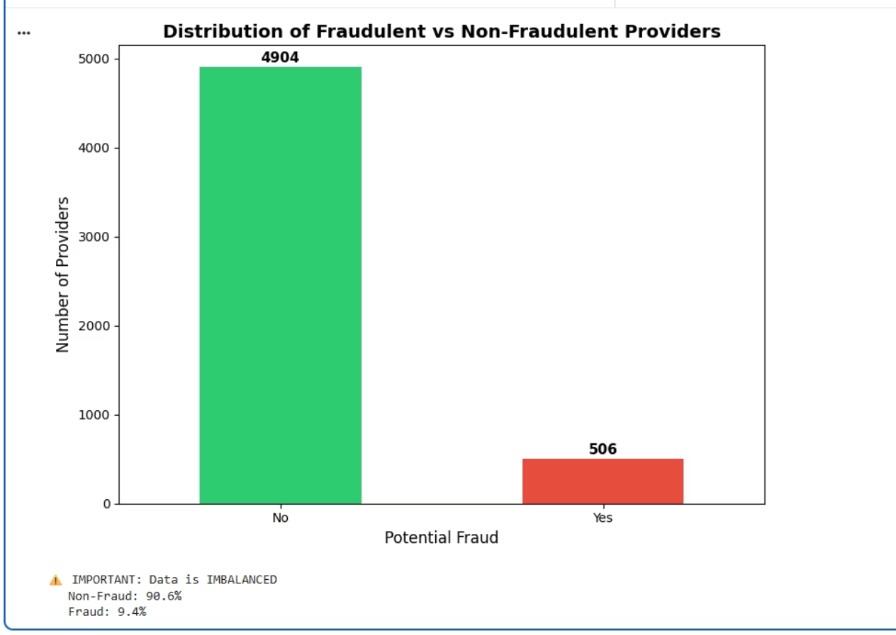
Phase 1: Data Understanding & Exploration
Key Data Insights
Fraudulent providers exhibit distinct patterns:
Higher Claim Amounts: Often submit claims for larger sums.
Increased Claims per Patient: More frequent claims for individual patients.
Disproportionate Ratios: Variations in inpatient/outpatient claims ratios.
These indicators highlight behavioral anomalies distinguishing fraudulent from legitimate activity.
Datasets: Beneficiary, Inpatient, Outpatient, LabelsClass Imbalance: A significant challenge, with ≈90% non-fraudulent and ≈ 10% fraudulent providers.

Slide 6
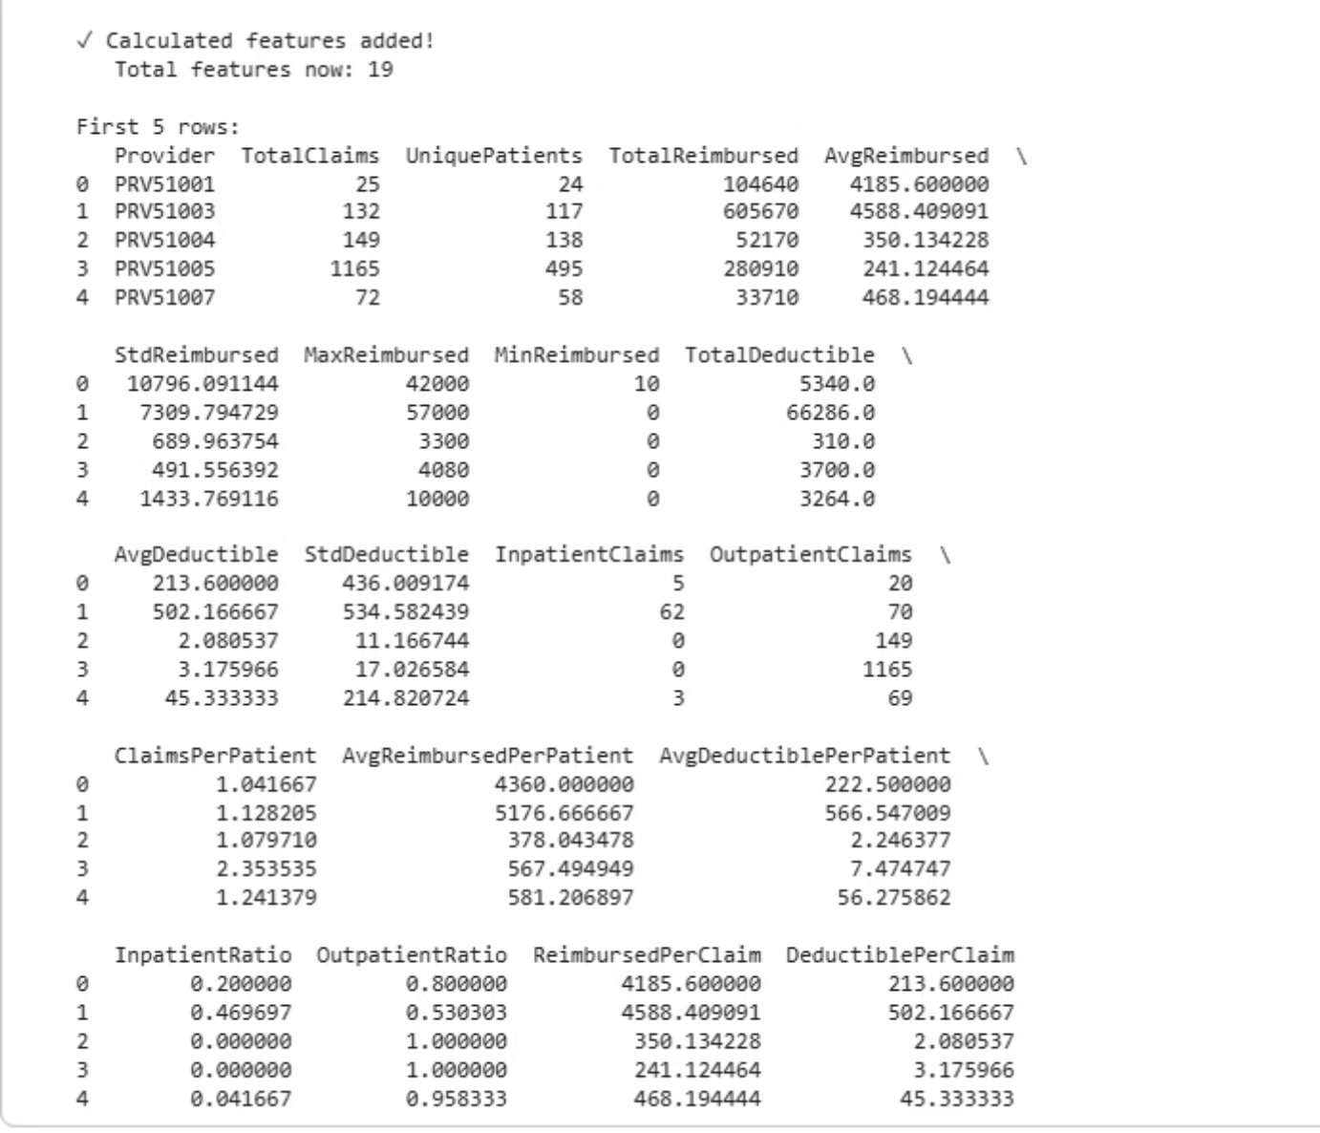
Phase 1: Feature Engineering & Data Cleaning
From Raw Data to Actionable Insights
Data Imputation: Systematically cleaned and filled missing values across all datasets.
New Feature Generation: Created critical indicators such as Age, IsDeceased, Chronic Conditions Count, and Claims Per Provider.
Provider-Level Aggregation: Transformed granular claim data into summary statistics like TotalClaims, AvgReimbursed, and InpatientRatio per provider.
This meticulous process ensures our dataset is robust and optimized for machine learning, providing a comprehensive view of each provider's behavior.

Slide 7
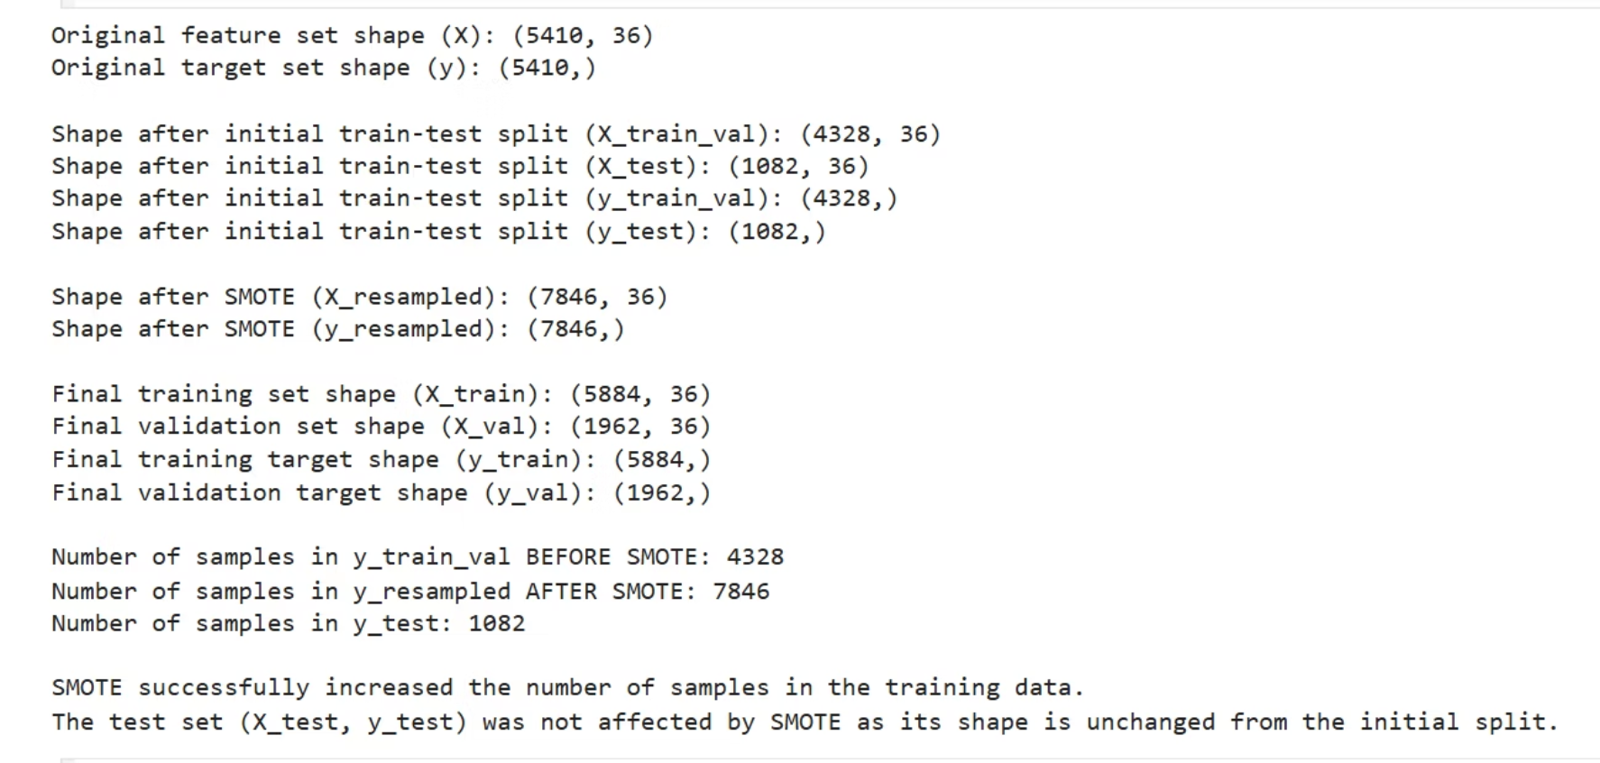
Phase 2: Handling Class Imbalance with SMOTE
Before SMOTE
Training Data:90% Non-Fraud10% Fraud
After SMOTE
Training Data:50% Non-Fraud50% Fraud
By balancing the training data, we ensure our models learn effectively from both fraudulent and non-fraudulent patterns, leading to more accurate and robust fraud detection.
SMOTE (Synthetic Minority Over-sampling Technique) was crucial for generating synthetic samples of the minority class. This prevents our models from being biased towards the overwhelmingly large majority class.

Slide 8
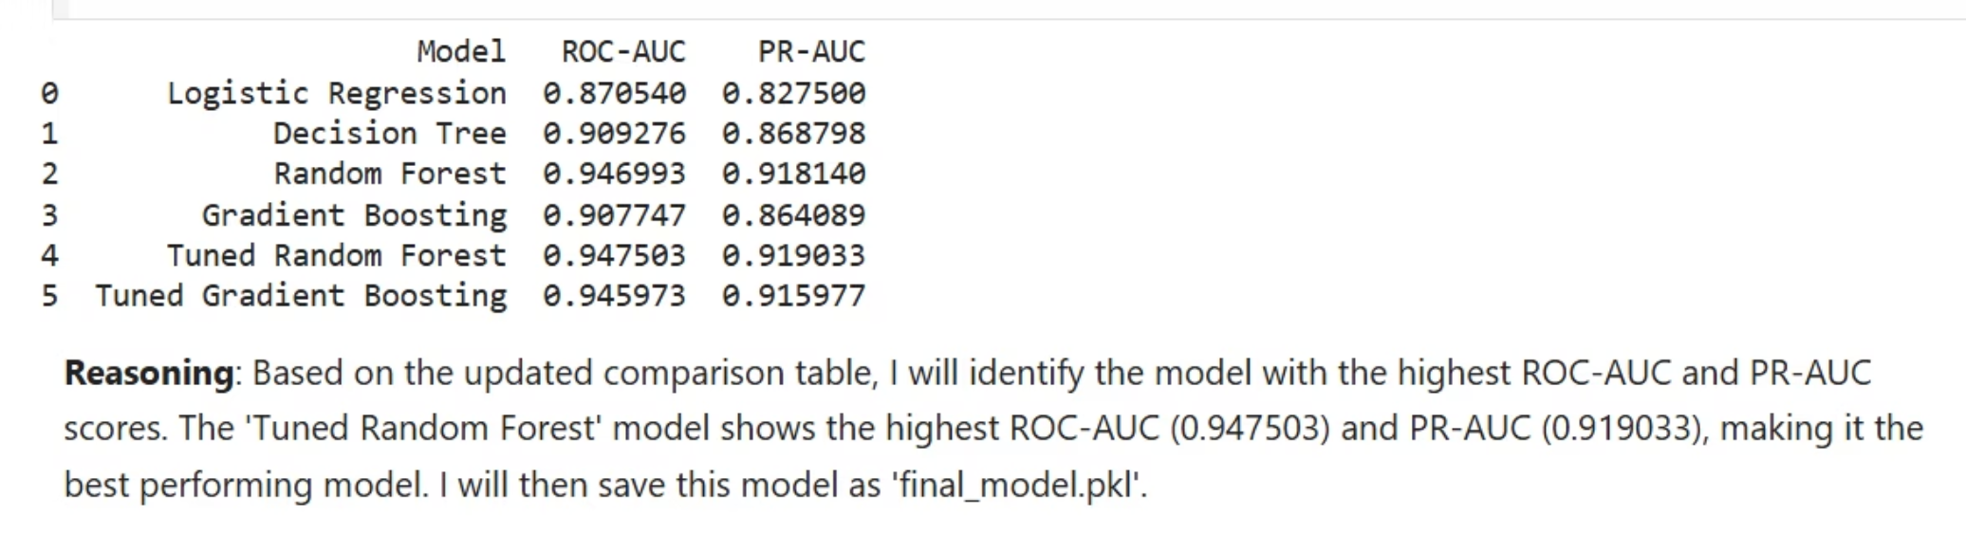
Phase 2: Model Comparison & Main Results
Models Trained
1
We evaluated Logistic Regression, Decision Tree, Random Forest, and Gradient Boosting to identify the most effective algorithm.
Random Forest: The Champion
Outperformed all other models, demonstrating superior capability in identifying complex fraud patterns.
ROC-AUC = 0.95: Excellent discrimination between classes.
PR-AUC = 0.92: High precision and recall, crucial for imbalanced datasets.
2
The Random Forest model's strong performance on both ROC-AUC and PR-AUC indicates its reliability in identifying fraudulent providers while minimizing false positives, making it ideal for our objectives.

Slide 9
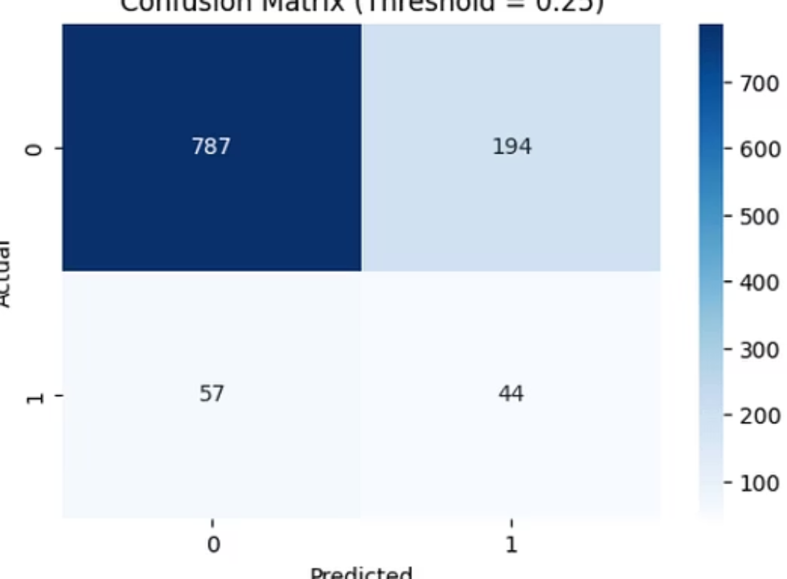
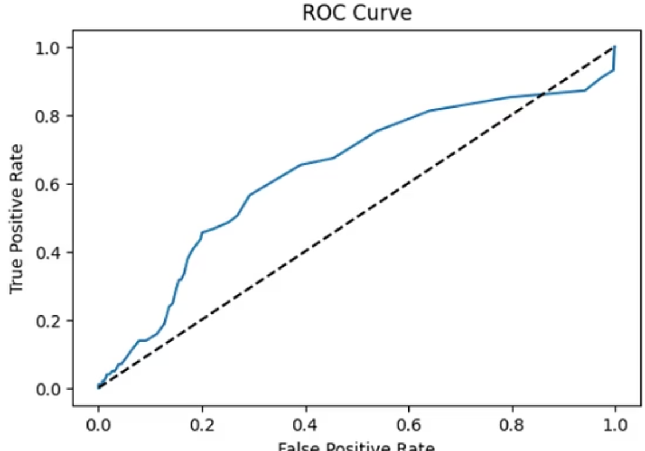
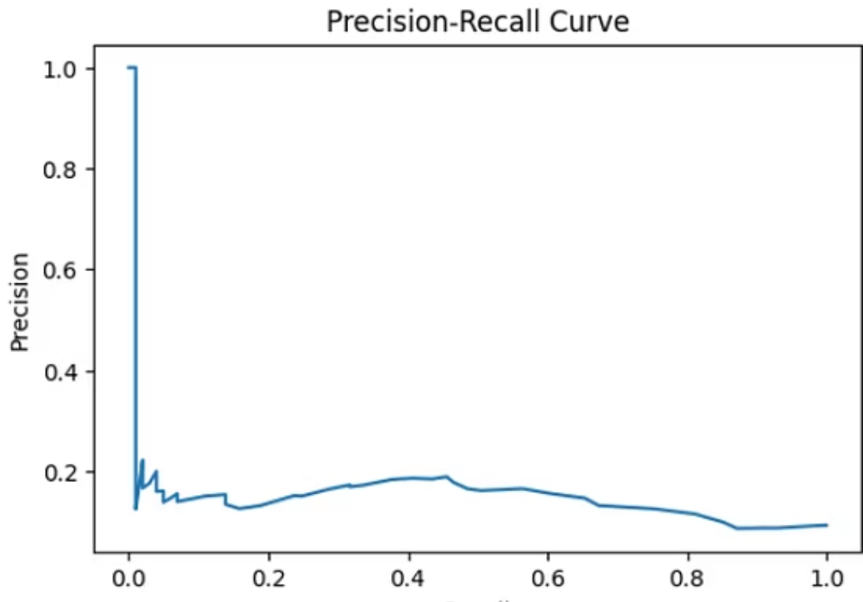
Phase 3: Threshold Tuning & Evaluation
Optimal Threshold: 0.25
Enhanced Recall
Acceptable Precision
After rigorous testing, a threshold of 0.25 provided the best balance between catching fraud and minimizing false alarms.
Significantly reduces missed fraudulent cases, ensuring more illicit activities are detected.
Maintains a low rate of false positives, preventing unnecessary investigations into legitimate providers.
This optimized threshold ensures that Medicare resources are directed efficiently, focusing investigations on the highest-risk providers without overburdening the system with false leads.

Slide 10
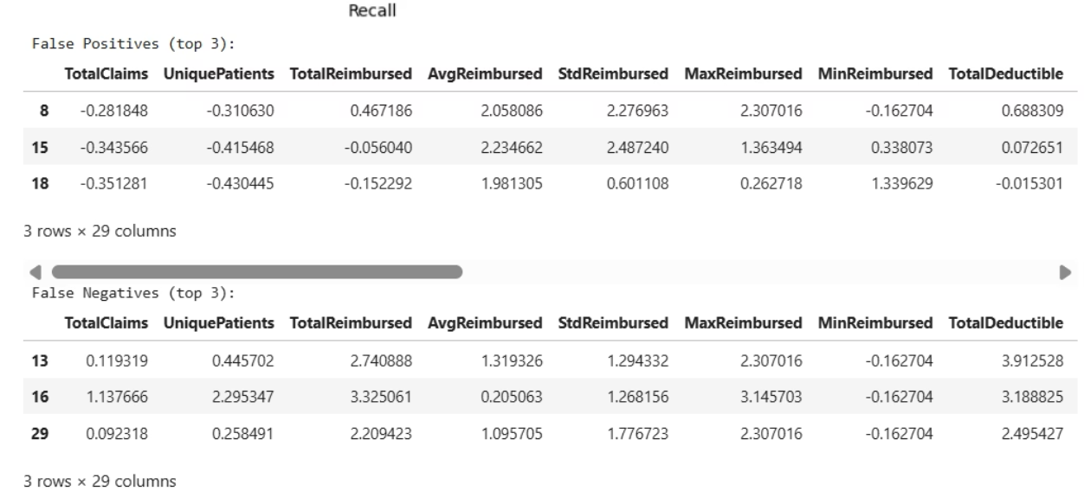
Error Analysis, Feature Importance, & Business Impact
Key Insights from Error Analysis
Transformative Business Impact
False Positives: Legitimate high-cost providers were sometimes flagged, indicating a need for more nuanced features related to practice specialty and volume.
Deployment Strategy: Monthly scoring of all providers, flagging the top 20% for in-depth investigation by Medicare.
False Negatives: Subtle fraud cases with less obvious patterns were occasionally missed, suggesting an opportunity for incorporating temporal trend analysis.
Top Contributing Features
Expected Outcomes:
ClaimsPerPatient: High frequency of claims for individual patients.
40% Reduction in investigation costs due to more precise targeting.
AvgReimbursed: Unusually high average reimbursement amounts.
InpatientRatio: Skewed proportions of inpatient vs. outpatient claims.
ChronicConditions: The number of chronic conditions linked to claims.
30% Increase in the detection rate of fraudulent activities.

Slide 11
THANK YOU
any questions?

